Slide 1
Autonomous Helicopter
By
David Mason
Adam Gould
Shaquana Peterson
Edward Budimier
Jens Johnson

Slide 2
Project Description
Team 1, Project Autonomous Helicopter consists of five team members working together to develop an autonomous flight system for an RC helicopter.
In order to call the project a success, the following criteria should be met:
Autonomous lift off and hover
Autonomous landing
Autonomous object avoidance exploration routine
Autonomous wall following routine

Slide 3
Timeline
Project Schedule
Activity | Cycle 1 |  |  |  | Cycle 2
 | 10FEB-16FEB | 17FEB-23FEB | 24FEB-2MAR | 3MAR-9MAR | 10MAR-16MAR | 17MAR-23MAR | 24MAR-30MAR | 31MAR-6APR | 7APR-13APR | 14APR-20APR
Wireless Comm
Balance Helicopter
Program Sonar Sensors
Program IR Sensor
Repairs/Ordering parts
Complete Prototype
Prototype testing
Complete Project
Milestones
1. Performance of sensors confirmed
2. Communication between microcontroller and helicopter controller confirmed
3. Developed a logic flowchart for helicopter's autonomous actions
4. Mounted Necessary parts onto helicopter and begin prototype testing
5. Helicopter tested to ensure proper autonomous function

Slide 4
Accomplishments
Purchased all parts needed for project.
Tested Helicopter Payload
Programmed Ultrasonic and IR sensors
Interfaced with Remote Control and Transmitter
Experimented with IR sensor for E-Day
Developed rudimentary optical altitude control.

Slide 5
Obstacles and Strategies
Control board Fried
  Purchased new board from Hong Kong
Flybar damaged
  Found more Resilient Material
  Spaced Rotor Blades
Blade Broken
  Replacements were purchased with the Helicopter
Interfacing with Remote
  Explore different methods of signal generation

Slide 6
Risks Faced
Virtual Signal Transmission
Wireless Communications
Time Constraints

Slide 7
Budget
Component | Supplier | Unit Cost | Quantity | Total Cost
3.5-Ch Metal Outdoor RC Helicopter Volitation 9053 | E Toys World | $68.25 | 1 | $68.25*
Arduino Fio | sparkfun.com | $24.95 | 2 | $49.90*
FTDI Basic Breakout | sparkfun.com | $14.95 | 1 | $13.95*
Main Rotor Blade Set A And B 4 | Superstition Hobbies | $8.24 | 1 | $8.24*
XBee 1mW Chip Antenna | sparkfun.com | $22.95 | 2 | $45.90*
Break Away Headers - Machine Pin | sparkfun.com | $2.95 | 1 | $2.95*
Polymer Lithium Ion Battery | sparkfun.com | $8.95 | 1 | $8.95*
Polymer Lithium Ion Battery - 20mAh | sparkfun.com | $5.95 | 1 | $5.95*
Triple Output LED RGB-Clear | sparkfun.com | 1.95 | 2 | $3.90*
Infrared Proximity Sensor Long Range | sparkfun.com | $14.95 | 1 | $14.95*
9V Snap Connector | sparkfun.com | $1.25 | 1 | $1.25*
9V to Barrel Jack Adapter | sparkfun.com | $2.95 | 1 | $2.95*
Arduino Uno SMD | sparkfun.com | $29.95 | 1 | $29.95*
Total Estimated Project Cost |  |  |  | $207.99*

Slide 8
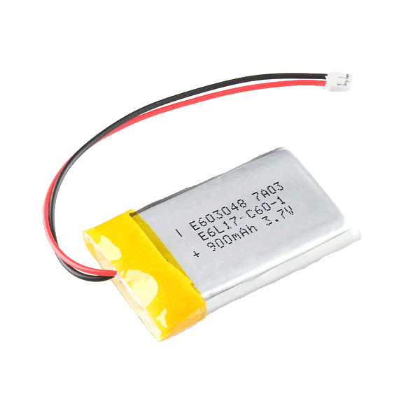
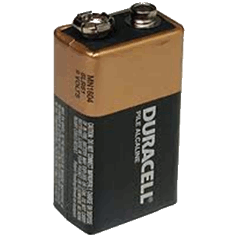
Batteries
Lithium Polymer - Primary
Lightest Weight vs. Power Density
Fio compatible
$8.95 + 5.95 = $14.90
9 Volt Alkaline – Secondary
Cheap
High Voltage
Heavy
$2.50

Slide 9
Power Supplies and Balance
Arduino and sensor power supply.
Weight distribution.

Slide 10
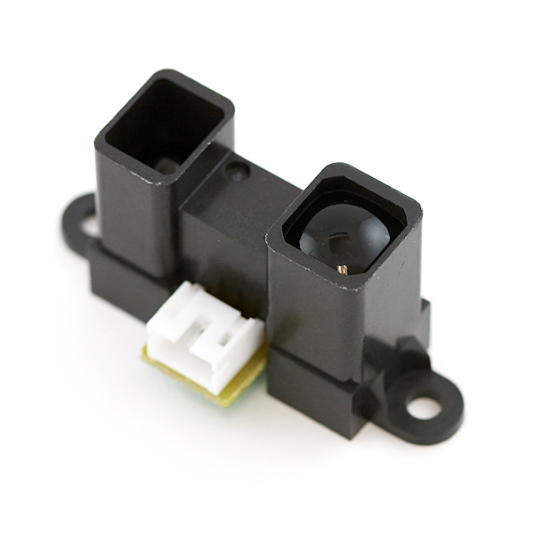
Sharp IR Range Finder Sensor
Less Accurate
Less Open Source Code
Cheap $14.95 each
Better for Motion Detection

Slide 11
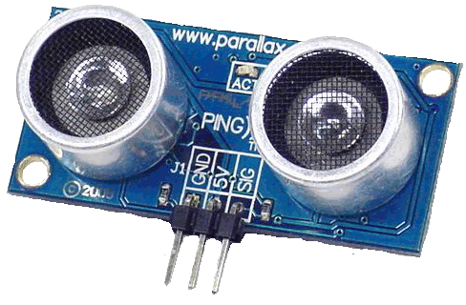
PING))) Ultrasonic Range Sensor
Sufficient Range
Accurate Distance Sensing
Open Source
Donated By Dr. Roppel = $0.00
Wall Sensor
Floor Sensor
Front Facing

Slide 12
Forward Facing Wall Sensor
Wall detection and object avoidance.

Slide 13
Downward Facing Hover Control Sensor
Altitude detection.
Hover control.
Take off and landing feedback.

Slide 14
Side Facing Parallel Control Sensors
Wall distance detection.
Parallelism.
Wall following.

Slide 15
Sensor System

Slide 16
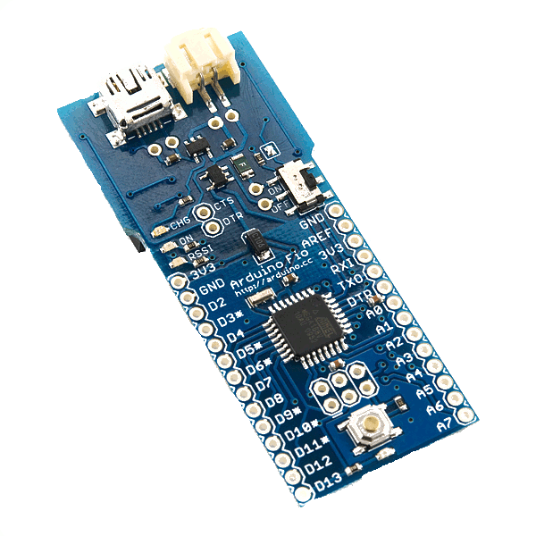
Arduino Fio x 2
Compact
Light Weight
X-Bee Ready
Li-Po Battery Compatable
Battery Charger
$24.95 x 2 = $49.90
Remote Board Heli-Sensor Board

Slide 17
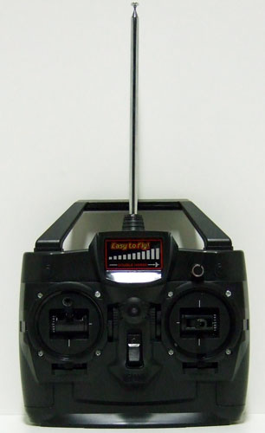

Micro Controller-Controlled
RF Remote Control
Transmitter Wired directly to Fio with xBee receiver
Right Stick Potentiometer
Bypass to Control Heading
and Airspeed
Left Stick Potentiometer
Bypass to control Altitude

Slide 18
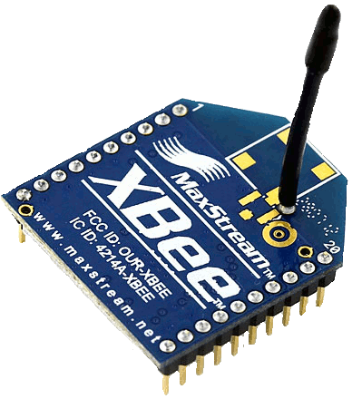
X-Bee Transceiver
Provides Wireless Communication
between Arduino Fio Micro Controllers
$22.95 x 2 = $45.90

Slide 19
Arduino Fio and X-Bee Transceiver
Sensor Feedback through
Wireless communication.

Slide 20
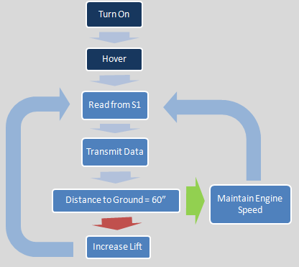
Logic Flow Diagram
S4
S3
S2
S1

Slide 21
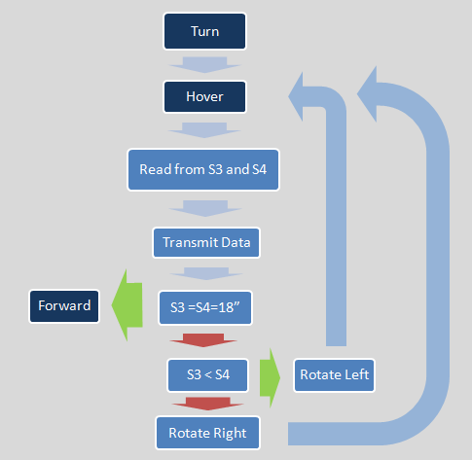
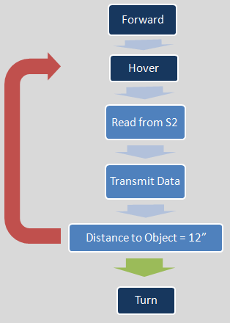
Logical Flow Diagram

